Slide 1
I/O, Asynchrony, and Coroutines (I)
Zhenbang You
zhenbangyou@pku.edu.cn

Slide 2
Background: Optimizing I/O-bound Programs
Example
Web server
E.g., course enrollment website (you must have seen its collapse before)
Example in this lecture
Fetching a large amount of web pages

Slide 3
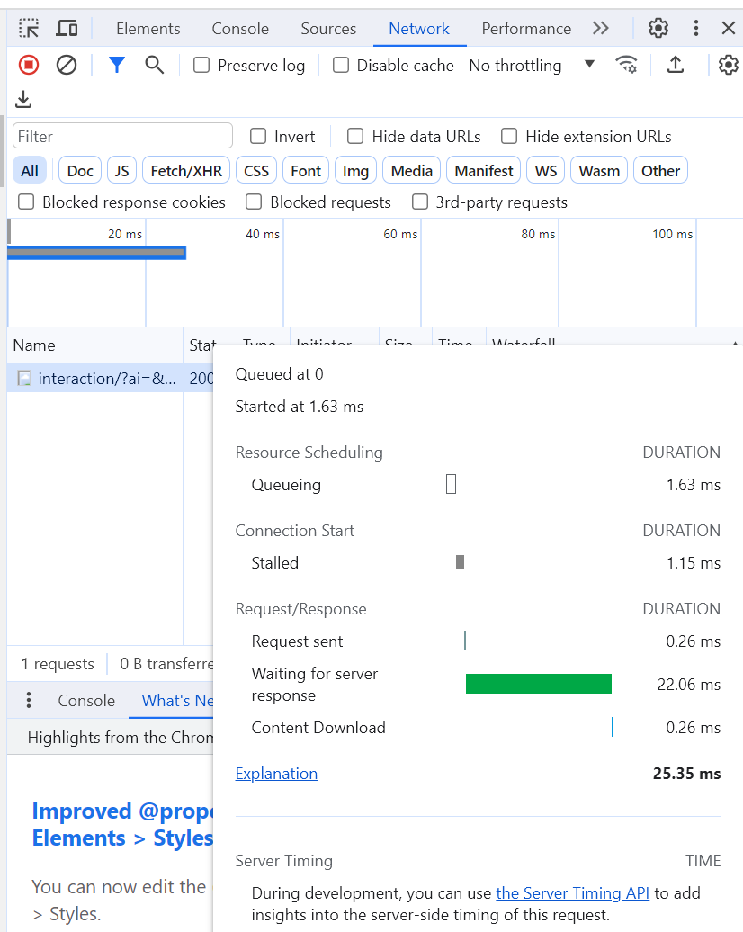
Time Decomposition of Getting a Web Page
How to obtain this waterfall graph?
Go to Chrome, press F12, then click Network
Observation
Most of time is spent in waiting for server response
CPU utilization is LOW!
Inspiration
A CPU core can handle a large amount of outstanding HTTP requests
How to do this?
Asynchronous programming!

Slide 4
Time Decomposition of Getting a Web Page
For compute-bound programs, we do parallel computing
For I/O-bound programs, we do asynchronous programming
Coroutines is a technique of asynchronous programming (probably the best we’ve ever known)

Slide 5
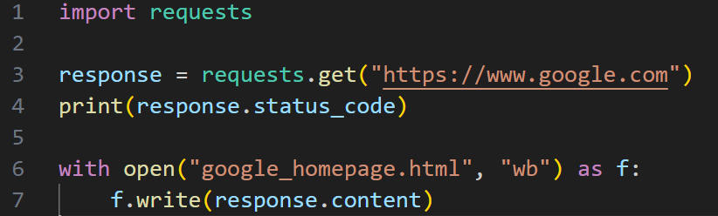



Essence of Getting a Web Page
HTTP GET request -> response
Paired (request, response) is the common pattern of HTTP
Client sends a request to server, and server sends back a response
There’re multiple types of requests, GET is one of them
We can do this in Python!
Get a web page with one line of Python!
This HTML file can be opened by a browser!

Slide 6









Performance Engineering
Solution 1: Naïve (sequential)
These waterfall graphs are just to show the basic idea. They are highly inaccurate (e.g., the portion of CPU time is way lower in HTTP requests)

Slide 7












Performance Engineering
Solution 2: Multithreading (assume single core)
In practice, $\frac{context switch time}{CPU time}$ is way higher than this. Key opportunity for further optimization (asynchronous programming)!

Slide 8
Performance Engineering
Solution 3: Asynchronous programming
Minimizing the overhead of context switch!
Basic idea: put all outstanding requests in the same thread, and switch among them
Easier said than done!
Let’s talk about this step by step

Slide 9
Performance Engineering
Warmup: What does “asynchronous” mean?
A-synchronous, not synchronous
Think about function calls.
Normal function are synchronous – when the function returns, we will have the result
Asynchronous functions will return regardless of if the result is ready
Otherwise, you would lose asynchrony
Analogous to spawning a new thread
Thread spawning will return regardless of if the entry function of the thread is complete
Otherwise, you would lose concurrency

Slide 10
Asynchronous Programming
Milestone 1: Fetch one web page
Asynchronous programming is only advantageous when there’re many I/O requests
Thus, Milestone 1 is useless in real scenarios, but it’s a cornerstone for further optimization
Unfortunately, this is the hardest milestone due to new concepts
Two major difference compared to previous methods
Programming paradigm (welcome to async world!)
Async I/O functions
The ecosystem of async programming wouldn’t be complete without either of them
New concepts (terminology varying among languages, but ideas are similar)
Coroutines (coros)
Lazy, representing an async job that can be started to form a task.
Tasks
An executing job

Slide 11
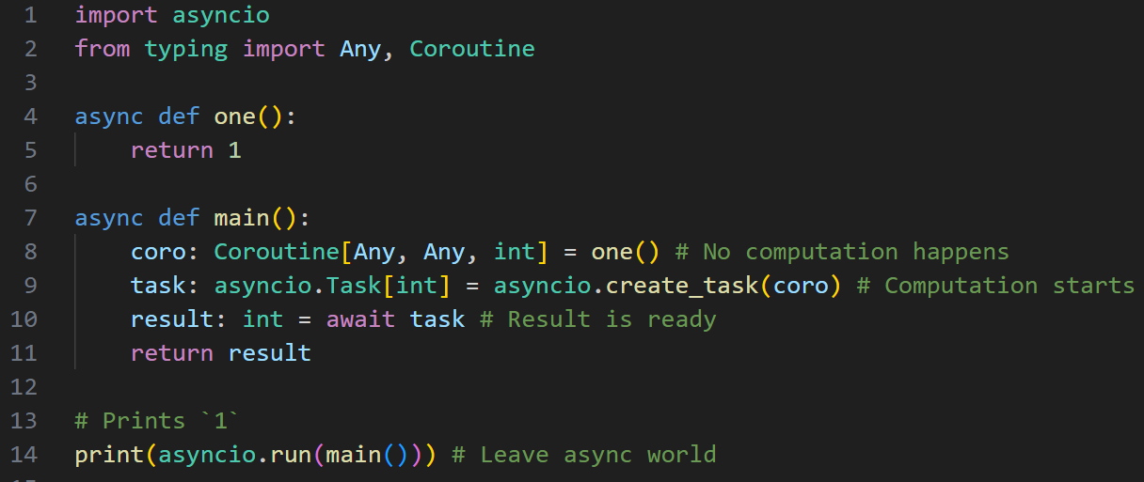





Asynchronous Programming
Preparation for Milestone 1
What happens when returning from an async function?
A coro is created. It wraps around a job (not started). The job is the execution of the function.

Slide 12
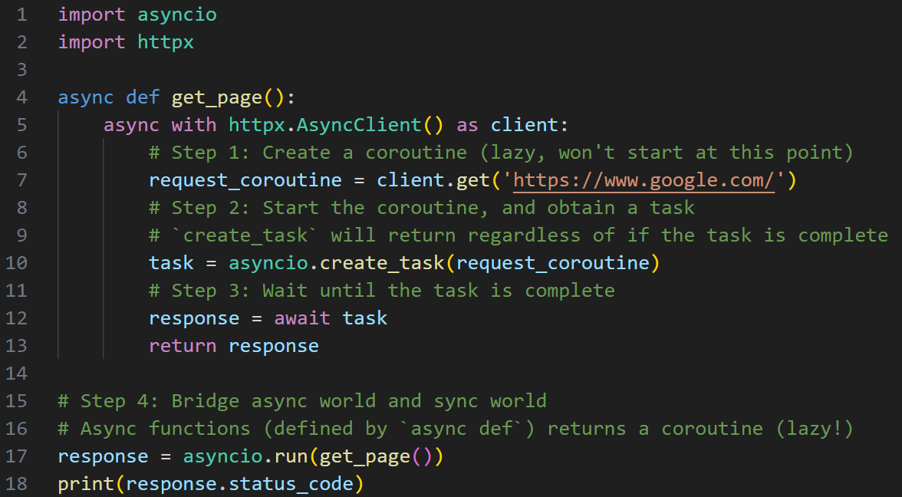
Asynchronous Programming
Milestone 1: Fetch one web page

Slide 13





Asynchronous Programming
Milestone 1: Fetch one web page
How many coros?

Slide 14
Asynchronous Programming
Milestone 1: Fetch one web page
How many tasks?

Slide 15






Asynchronous Programming
Milestone 1: Fetch one web page

Slide 16
Asynchronous Programming
Milestone 1: Fetch one web page
How to create a coroutine?
Return value of an async function
What happens when returning from an async function?
A coro is created. It wraps around a job (not started). The job is the execution of the function.

Slide 17




Asynchronous Programming
Milestone 1: Fetch one web page
How many way are there to start a coroutine?
asyncio.create_task
The coro starts running. `create_task` can return regardless of if the task is complete
Similar to starting a new thread
await (keyword)
Start a coro and wait for its completion
Will lose asynchrony when applying this to a coro
`await` can be applied to coros and tasks
`await` is only allowed in async functions (`async def`)
asyncio.run
The only bridge between the sync world and the async world

Slide 18
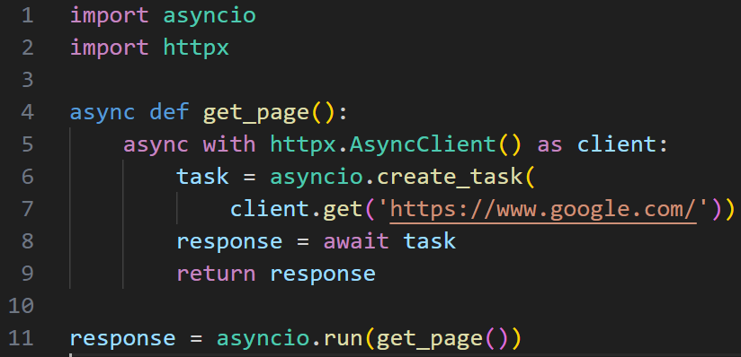
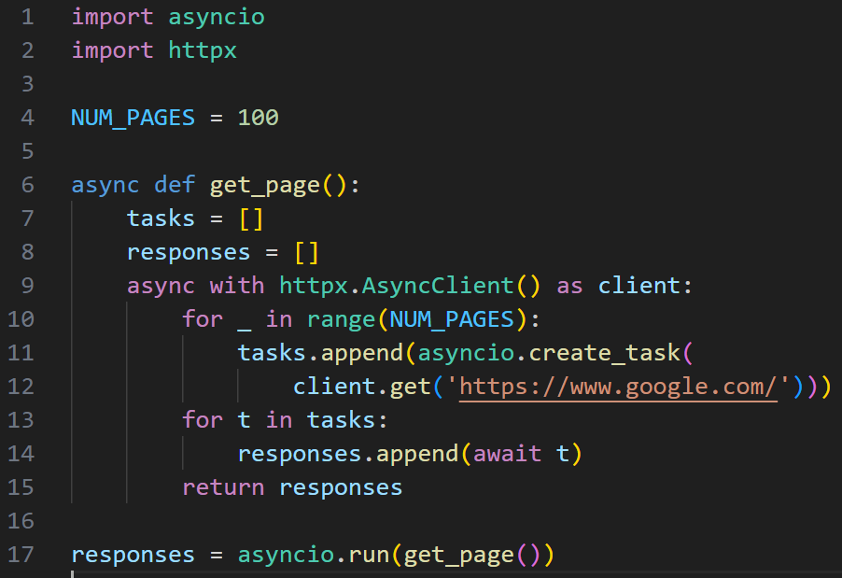
Asynchronous Programming
Milestone 2: Fetch multiple web pages
One Page
Multiple Pages

Slide 19



Asynchronous Programming
Milestone 2: Fetch multiple web pages
Phase 1: Issue all requests

Slide 20





Asynchronous Programming
Milestone 2: Fetch multiple web pages
Phase 1: Issue all requests
Phase 2: Wait for all requests to complete

Slide 21
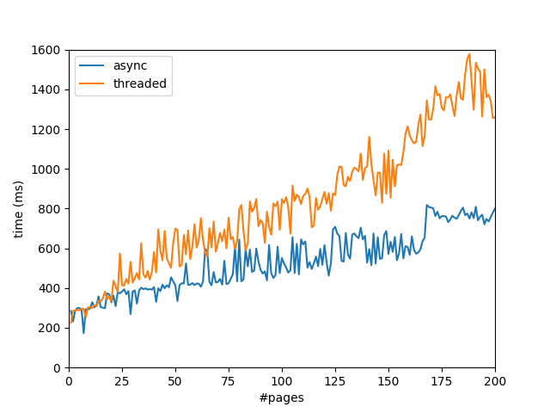
Asynchronous Programming
Speedup over multithreading:
Experiment setup
Rust tokio & reqwest
Python multithreading is too slow, giving me 10X between async and threaded at 100 pages
Getting the web page of https://www.rust-lang.org/
Better experiment should get pages of different website to avoid being bottlenecked by a single website
For each experiment, repeat 10 times, and take the shortest time
Hardware utilization is low (shown in the next slide)
Analysis
The gap increases with #pages
The async program is bottlenecked by the web server, not my machine

Slide 22

Asynchronous Programming
Hardware Utilization is LOW

Slide 23
Asynchronous Programming
Before moving on, let’s draw an analogy between coros and threads
In PL (programming language) terminology, a `task` in Python is considered a running coro, which is similar to a running thread
Coroutines is a technique of asynchronous programming (probably the best one we have ever found)
There’re 2 kinds of coros, stackful and stackless; we’re talking about the latter
For threads, the most important APIs are `spawn` (starting a new thread) and `join` (wait for the thread to complete and get the result)
Spawn/join
For coroutines, the most important APIs are coro constructor (create a new coro, and optionally start it) and `await` (wait for the coro to complete and get the result)
Since coro construction always involve async functions, people often call this programming model as “async/await”

Slide 24
Asynchronous Programming
Milestone 3: More complex coro entry functions
Coros are similar to threads
Threads can have arbitrary entry functions
Coros can do the same!
The only exception: the entry function should return a coro, essentially being an async function
Previously, our coro entry function was just `httpx.AsyncClient.get` (async HTTP GET request). We’re to wrap it into a function

Slide 25
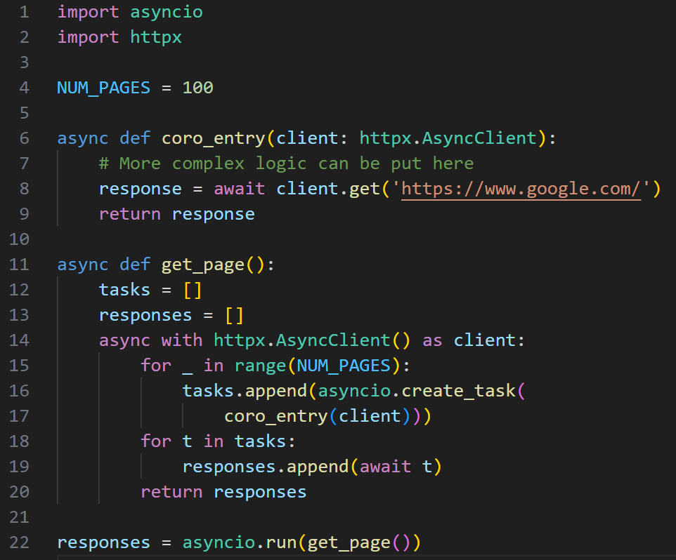
Asynchronous Programming
Milestone 3: More complex coro entry functions

Slide 26
Asynchronous Programming
Milestone 3: More complex coro entry functions
How many coros?

Slide 27
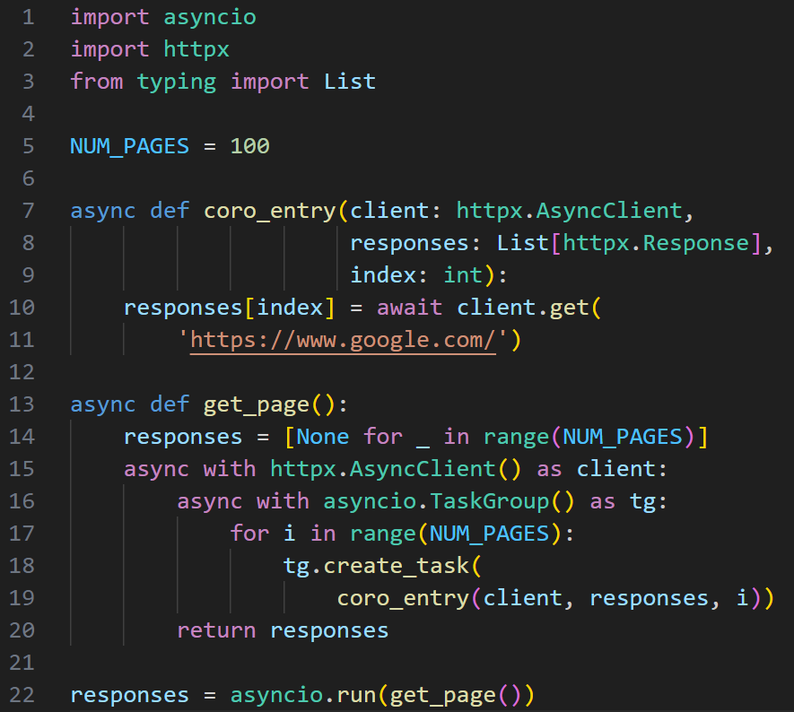
Asynchronous Programming
Milestone 4 (bonus): Task groups (hierarchical structure)
New feature in Python 3.11

Slide 28



Asynchronous Programming
Milestone 4 (bonus): Task groups (hierarchical structure)
All coros started by `tg` will complete within this scope

Slide 29

Coroutines Under the Hood
Coros are similar to threads, what does context switch look like in coros?
High level
Every `await` is a suspension point
Compiler computes the minimal context by live-variable analysis
Context is saved to heap objects
Low level (system calls)
I/O Multiplexing (e.g., epoll)
Non-blocking I/O (e.g., non-blocking sockets)

Slide 30
Coroutines Under the Hood
Coros are similar to threads, what does context switch look like in coros?
High level
Every `await` is a suspension point
Compiler computes the minimal context by live-variable analysis
Context is saved to heap objects
Low level (system calls)
I/O Multiplexing (e.g., epoll)
Non-blocking I/O (e.g., non-blocking sockets)
Topics in future tutorials!

Slide 31
Special Notes
In Python’s terminology, the unit of scheduling is tasks, NOT coros
Think about multithreading, we care about the number of threads
Here, we care about the number of tasks
Since tasks in other languages are considered (running) coros, when people talk about the number of coros, what they refer to is probably the number of tasks in Python
Thus, what matters is the number of tasks, rather than the number of coros
Coros can be composed and form another coro

Slide 32
References
Coroutines and Tasks in Python
https://docs.python.org/3/library/asyncio-task.html
Coroutines in other programming languages
Kotlin Coroutines: https://kotlinlang.org/docs/coroutines-overview.html
Rust Tokio: https://tokio.rs/
C# (F# has similar mechanisms): https://learn.microsoft.com/en-us/dotnet/csharp/asynchronous-programming/
Swift Concurrency: https://docs.swift.org/swift-book/documentation/the-swift-programming-language/concurrency/
JavaScript async function: https://developer.mozilla.org/en-US/docs/Web/JavaScript/Reference/Statements/async_function

